Slide 1

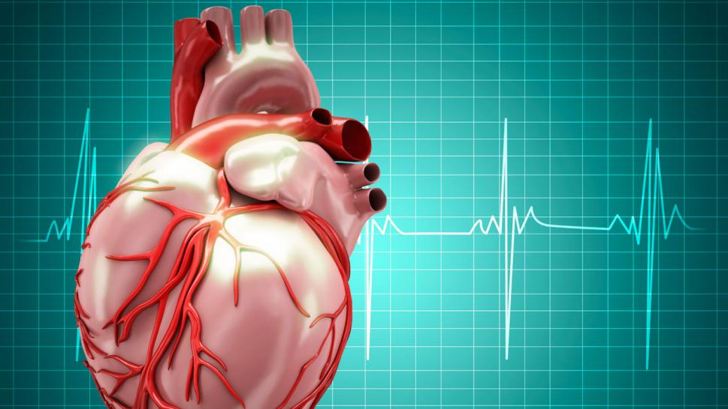
Cardiomyopathy
By:
Mohey Eldeen A. Eldeeb
Prof. of Cardiology

Slide 2
ILOs
Indented Learning Outcomes (ILOs)
*Definition of cardiomyopathy
*Types of Cardiomyopathy
*Clinical features, investigations, Lines of therapy, medical, interventional and surgical.
*Complications.
*Differentiate from other diseases (eg. restrictive and constrictive, obstructive LV dis and AS)
*Encourage family screening in some types of myopathy.
*Importance of cardiac rehabilitation
*Suitable advices (exercise vs HOCM)

Slide 3
Cardiomyopathyuction
Is a myocardial disorder in which the heart muscle is structurally and functionally abnormal, in the absence of coronary artery disease (CAD), hypertension, valvular disease, and congenital heart disease (CHD) sufficient to cause the observed myocardial abnormality’.
The myocardium becomes enlarged, abnormally thick or rigid. In rare cases, the muscle tissue in the heart is replaced with scar tissue.
As cardiomyopathy progresses, complications can evolve e.g heart failure, arrhythmias, systemic and pulmonary edema and, rarely, infective endocarditis

Slide 4

cardiomyopathy
Morphological and functional traits used to describe cardiomyopathy phenotypes
Morphological traits
Ventricular hypertrophy: left and/or right
Ventricular dilatation: left and/or right
Non-ischaemic ventricular scar and other myocardial tissue characterization features on cardiac magnetic resonance
Functional traits
Ventricular systolic dysfunction (global, regional)
Ventricular diastolic dysfunction (restrictive physiology)

Slide 5
Types of cardiomyopathy
Cardiomyopathy phenotypes are:
1. Dilated cardiomyopathy
2. Non-dilated left ventricular cardiomyopathy
3. Hypertrophic cardiomyopathy
4. Restrictive cardiomyopathy
5. Arrhythmogenic right ventricular cardiomyopathy

Slide 6
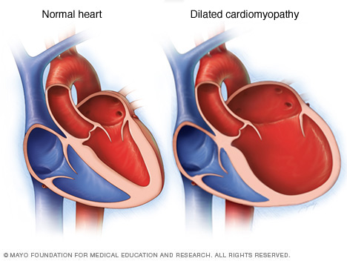
Dilated Cardiomyopathy

Slide 7

Dilated Cardiomyopathy (DCM)
Dilated Cardiomyopathy is a spectrum of heterogeneous
myocardial disorders that are characterized by the presence
of LV dilatation and systolic dysfunction unexplained solely
by abnormal loading conditions or ischemic heart disease.

Slide 8
Etiology of Dilated Cardiomyopathy
*Genetic (familial)
*Toxins (alcohol, cocaine, chemotherapy such as anthracycline)
*Inflammatory (such as collagen vascular disease, hypersensitivity myocarditis)
*Nutritional (thiamine and selenium deficiencies)
*Peripartum cardiomyopathy
*Endocrine (diabetes, hypothyroidism, and hyperthyroidism)
*Tachycardia-mediated
*Stress induced (takotsubo)
*Chagas disease
*Viral (post myocarditis, HIV-related)

Slide 9
Dilated Cardiomyopathy
Most common form of cardiomyopathy occurs in male adults aged 20 to 60 years
C/P:
symptoms of heart failure: fatigue, edema, and SOB
It can also lead to valvular regurgitation, arrhythmias, and intracardiac thrombosis, emboli formation

Slide 10
On examination:
Physical signs vary according to the degree of compensation, chronicity, and chamber involvement
patients with significant but well-compensated systolic HF may reveal no abnormalities
Volume overload is the hallmark of HF (Jugular venous distension (JVD), Pulmonary rales, Ascites, Pedal edema )
Signs of hypoxia (eg, cyanosis, clubbing)
Tachycardia and narrow pulse pressure, Pulsus alternans or a low-amplitude pulse
Goiter if dysthyroidism is suspected
S₃ gallop, A holosystolic murmur of mitral regurgitation

Slide 11
Pathophysiology
DCM is characterized by ventricular chamber enlargement and systolic dysfunction with greater left ventricular (LV) cavity size with little or no wall
Progressive dilation can lead to significant mitral and tricuspid regurgitation, which may further diminish the cardiac output and increase end-systolic volumes and ventricular wall stress. In turn, this leads to further dilation and myocardial dysfunction.
Pathophysiology

Slide 12
Pathophysiology
In decompensation of systolic heart failure, several changes in the pressure-volume (P-V) curve are seen
Neurohormonal activation, including stimulation of the adrenergic nervous system and the renin-angiotensin-aldosterone system (RAAS
Release of circulating cytokines as mediators of myocardial injury as TNF, IL6

Slide 13
Etiology
Laboratory work
Is used to diagnose potentially reversible causes, identify comorbidities, monitor and correct abnormalities before or during treatment, and assess the disease severity
metabolic panel should be assessed on initial evaluation and then subsequently based on clinical judgment. Anemia is present in up to 40% of HF patients and is associated with increased mortality and functional impairment
The natriuretic peptides B-type natriuretic peptide (BNP) and N-terminal pro–B-type natriuretic peptide (NT-proBNP) are released in the setting of increased ventricular dilation or wall stress
DIAGNOSTIC EVALUATION

Slide 14
Etiology
Laboratory work
Other biomarkers as Troponin T or I may be elevated in chronic HF and demonstrate ongoing myocyte injury
Standard laboratory screening for modifiable cardiovascular risk factors including fasting lipid panel and serum glucose should also be obtained.
DIAGNOSTIC EVALUATION

Slide 15
Etiology
The electrocardiogram (ECG)
Sinus tachycardia is common. Other common abnormalities include left bundle branch block and ventricular or atrial arrhythmias, Chamber enlargement.
Chest Radiography
Reveals cardiomegaly, evidence for left and/or right heart failure, and pleural effusions
Echocardiogram
is indicated to exclude unsuspected valvular or other lesions and confirm the presence of ventricular dilatation, reduced LV systolic function and associated RV systolic dysfunction, or pulmonary hypertension
DIAGNOSTIC EVALUATION

Slide 16
Treatment:
The main goals of treating cardiomyopathy are to:
Manage any conditions that cause or contribute to the cardiomyopathy
Control symptoms so that the person can live as normally as possible
Stop the disease from getting worse
Reduce complications and the chance of sudden cardiac death

Slide 17
Treatment of DCM
Diet and Activity:
Fluid restriction is necessary in symptomatic stages of the disease.
Salt restriction to less than 2-4 g/day.
Encourage patients to exercise moderately, because deconditioning is a very common cause of dyspnea. Cardiac rehabilitation has been shown to improve patient outcomes.

Slide 18
Treatment of DCM:
Pharmacological treatment:
- Angiotensin-converting enzyme (ACE) inhibitors - Angiotensin II receptor blockers (ARBs) - Beta-blockers - Aldosterone antagonists - Cardiac glycosides - Diuretics - Nitrates - Vasodilators - Sacubitril-valsartan (ARNI)
- Antiarrhythmics
Human B-type natriuretic peptide
Inotropic agents
Anticoagulation

Slide 19

Treatment of DCM:
Non pharmacological treatment:
For patients with disease refractory to medical therapy. These include the following:
Left ventricular assist devices (LVADs)
Cardiac resynchronization therapy (biventricular pacing)
Automatic implantable cardioverter-defibrillators
Ventricular restoration surgery
Heart transplantation

Slide 20
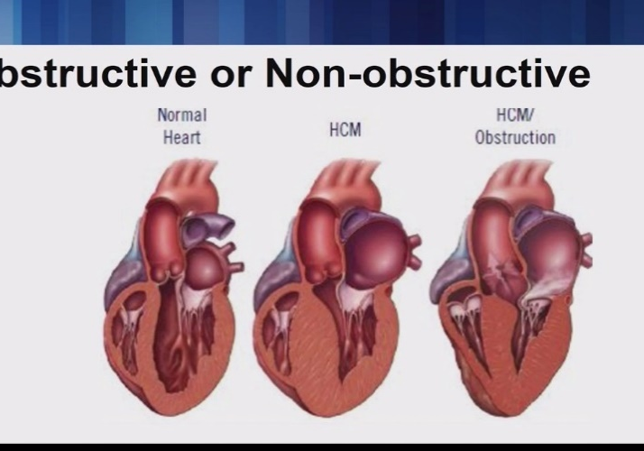
Hypertrophic Cardiomyopathy
Defined as the presence of left ventricular hypertrophy (LVH), LV wall thickness ≥15 mm in any myocardial segment that is not explained solely by loading conditions.
It appears to be inherited as autosomal dominant. It is a leading cause of sudden death among athletes aged less than 35 years
2 types
Obstructive
Non-obstructive ( about one third )

Slide 21
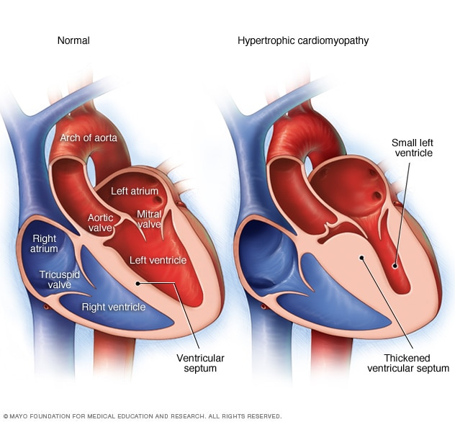
Obstructive Cardiomyopathy

Slide 22

Hypertrophic Obstructive Cardiomyopathy (HOCM)
The septum thickens and bulges into the left ventricle blocks the flow of blood into the aorta the ventricle must work much harder to pump blood past the blockage
Symptoms of LCO can include chest pain, dizziness, shortness of breath, or fainting.
It can also affect the mitral valve, causing blood to leak backward through the valve.

Slide 23

Hypertrophic Non-obstructive Cardiomyopathy
The entire ventricle may become thicker (symmetric ventricular hypertrophy) or it may happen only at the bottom of the heart (apical hypertrophy).
The right ventricle also may be affected.

Slide 24
Etiology:
Inherited as autosomal dominant because of a gene mutation in cardiac sarcomere protein genes , small percentage of adult cases are caused by other genetic disorders .
Some patients have non-genetic disorders that mimic genetic forms of the disease, for example amyloidosis

Slide 25
Pathophysiology
Asymmetrical Left ventricular hypertrophy dynamic LVOTO, mitral regurgitation (MR), diastolic dysfunction, myocardial ischemia, arrhythmias, and autonomic dysfunction.
leading to sudden cardiac arrest.
the clinical outcome may be dominated by one of these components or may be the result of a complex interplay
Pathophysiology

Slide 26
History and physical examination
Age is one of the most important factors to take into account when considering the possible causes for HCM.
Family -, unexplained heart failure, cardiac transplantation, pacemaker and defibrillator implants)
Many individuals with HCM complain of few, if any symptoms. In such cases the diagnosis can be incidental

Slide 27
History and physical examination
Some patients experience angina, dyspnoea, palpitations and syncope.
General examination can provide diagnostic clues in patients with syndromic or metabolic causes of HCM.
Cardiovascular examination is often normal but, in patients with (LVOTO) an ejection systolic murmur at the left sternal edge that radiates to the right upper sternal edge and apex.
Most patients with LVOTO also have signs of mitral regurgitation.

Slide 28
DIAGNOSTIC TESTING
ECG:
No specific changes that are pathognomonic for HCM. Could be Evidence of atrial enlargement, Q-waves in the inferolateral leads, Voltage criteria for large negative precordial T-waves.
Echocardiography
is the preferred diagnostic method because of its high sensitivity and low-risk profile. It allows characterization of the site and mechanism of obstruction, assessment for increased wall thickness. Recognition of mitral regurgitation (MR).
Magnetic resonance imaging (MRI)

Slide 29
Treatment of hypertrophic cardiomyopathy
Goals of management
treating symptoms of heart failure, arrhythmias, angina, and presyncope or syncope.
preventing sudden death.

Slide 30
Treatment of hypertrophic cardiomyopathy
Goals of management
treating symptoms of heart failure, arrhythmias, angina, and presyncope or syncope.
preventing sudden death.

Slide 31
Treatment of hypertrophic cardiomyopathy
Pharmacological treatment
*β-Blockers are considered first-line therapy, it inhibits sympathetic stimulation by the negative inotropic and chronotropic properties.
*Calcium channel blockers are considered to be second-line agents.
*Disopyramide, a class Ia antiarrhythmic agent, may be an effective alternative or adjunct to β-blocker and CCB therapy.
*Diuretics should be used cautiously for symptom reduction in the setting of pulmonary edema.

Slide 32


Treatment of hypertrophic cardiomyopathy:
Avoid
Inotropic drugs.
β-Blockers with additional α-blocking properties, such as carvedilol and labetalol, should be avoided because of their additional vasodilatory properties.
Digitalis

Slide 33
Treatment of hypertrophic cardiomyopathy
Non Pharmacological treatment
For those patients with symptoms despite optimal medical therapy
*Septal myectomy.
*Alcohol septal ablation.
*Dual-chamber pacing.

Slide 34
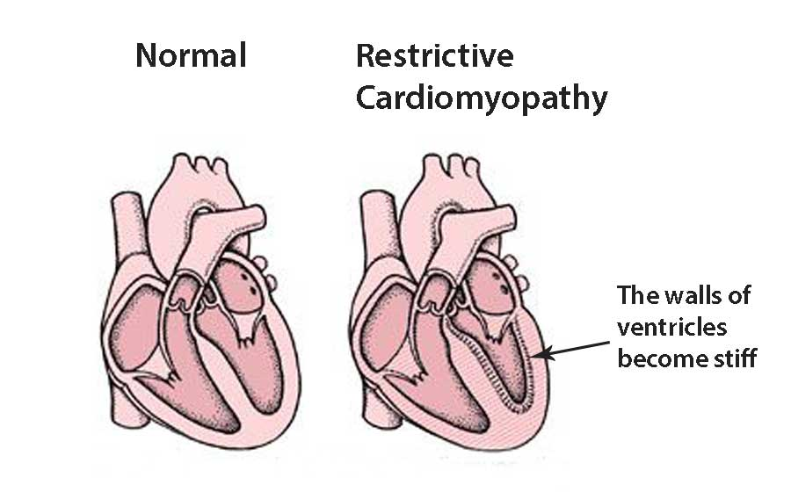
Restrictive Cardiomyopathy
tends to mostly affect older adults

Slide 35
Restrictive Cardiomyopathy (RCM)
RCM are a heterogeneous group of diseases characterized by a nondilated left ventricle, often with a well-preserved ejection fraction.
The predominant manifestation is diastolic dysfunction as a result of myocardial disease.
Some infiltrative cardiac diseases such as amyloidosis produce an RCM, whereas others, such as sarcoidosis, have an infiltrative component but are predominantly manifested as DCM.

Slide 36
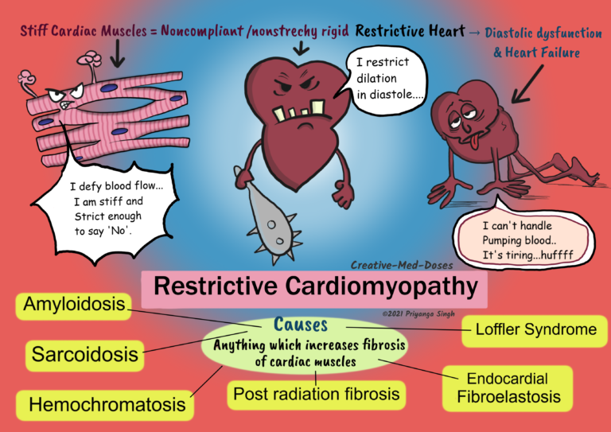
Restrictive Cardiomyopathy (RCM)

Slide 37
Pathophysiology
The ventricles become stiff and rigid due to replacement of the normal heart muscle with abnormal tissue, such as scar tissue.
As a result, the ventricles cannot relax normally and expand to fill with blood, which causes the atria to become enlarged.
Eventually, blood flow in the heart is reduced, and complications such as heart failure or arrhythmias occur.

Slide 38
Clinical Features of Idiopathic (RCM)
The disease is rare described in individuals from infancy to late adulthood; it usually carries a poor prognosis.
Symptoms:
are nonspecific and reflect the presence of heart failure. Dyspnea is an initial complaint in most patients, edema occurs in approximately half, and palpitations, fatigue, and orthopnea are reported by 22% to 33%..
Physical examination:
is usually consistent with biventricular heart failure, with jugular venous distention noted in most patients but ascites and significant edema being found in advanced cases. AF is common, and a third heart sound is heard in one in four patients; murmurs are not a feature.

Slide 39

Investigations:
ECG: has normal voltage, with only a minority of patients showing intraventricular conduction delay
Echocardiography:
Reveals a typical pattern of biatrial enlargement and nondilated ventricles with a normal LV ejection fraction and LV wall thickness .
Cardiac magnetic resonance imaging (MRI) (most important)
Labs:
Comprehensive metabolic panel
Thyroid function tests
Renal and liver function tests
Cardiac biomarkers
B-type natriuretic peptide assay

Slide 40
Investigations:
Endocardial biopsy.
Cardiac catheterization.
N.B. Endomyocardial biopsy demonstrates nonspecific findings such as myocyte hypertrophy, interstitial fibrosis, and, not uncommonly, endocardial fibrosisand it may be helpful in diagnosing myocarditis, connective tissue disorders, and amyloidosis.

Slide 41
Differential diagnosis of RCM from constrictive pericarditis
Constrictive pericarditis is more difficult to differentiate from RCM because most of the clinical features overlap between the two disorders.
A thickened pericardium noted on echocardiography, CT, or CMR in a patient with heart failure and a preserved ejection fraction without wall thickening suggests constrictive pericarditis.
Advanced echocardiographic techniques may be of help in distinguishing constrictive pericarditis from RCM, but endomyocardial biopsy may be required unless an alternative diagnosis is clear.

Slide 42
Treatment of RCM
Restrictive cardiomyopathy (RCM) has no specific treatment. However, therapies directed at individual causes of RCM have been proven to be effective
The mainstays of medical treatment is generally limited to medical treatment of heart failure, diuretics, vasodilators, and angiotensin-converting enzyme inhibitors (ACEIs) as indicated, as well as anticoagulation (if not contraindicated)
In selected patients, permanent pacing, left ventricular assist device (LVAD) therapy, and transplantation (heart or heart-liver) may be considered.

Slide 43

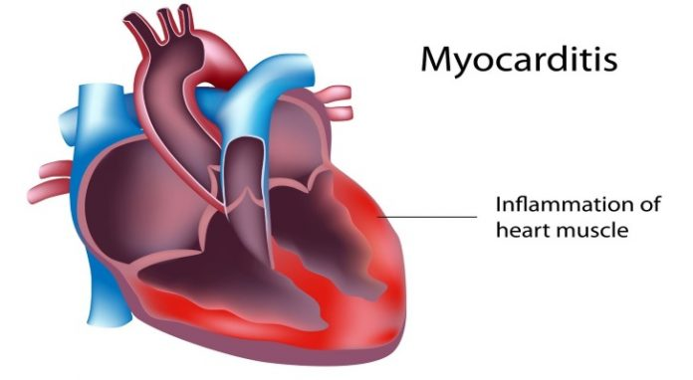
Myocarditis
Definition
Inflammation of the myocardium with associated necrosis or degeneration, or both, and often with pericardial inflammation (myopericarditis).
Incidence
Unclear; the syndrome is underdiagnosed because of the large number of asymptomatic cases. Myocarditis usually affects younger individuals; the median age of patients with lymphocytic myocarditis is 42 years

Slide 44
Etiology of Myocarditis
Exposure to :
external antigens, such as viruses, bacteria, parasites, toxins, or drugs
internal triggers, such as autoimmune activation against self-antigens.
The primary causes of myocarditis are viral infections (coxsackie virus , adenovirus, parvovirus B19 and human herpes virus 6) and a variety of toxic and noninfectious triggers.

Slide 45
Etiology of myocarditis

Slide 46
https://www.slideshare.net/magdyelmasry1422/myocarditi

Slide 47
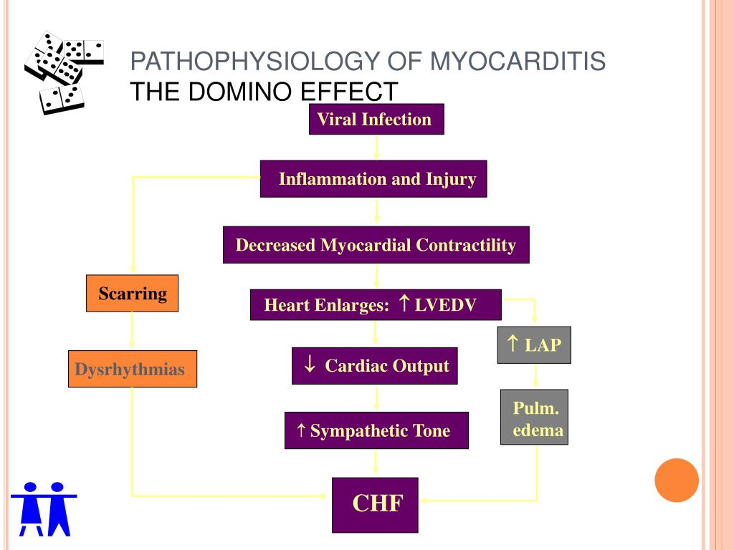
Pathophysiology of myocarditis
Https://image.slideserve.com/761169/pathophysiology-of-myocarditis-the-domino-effect-l.jpg

Slide 48
CLINICAL SYNDROMES
A wide-range of potential clinical presentations
Asymptmatic ECG or echocardiographic abnormalities.
Classically, present with nonspecific symptoms related to the heart
The most common symptoms included fatigue (82%), dyspnea on exertion (81%), arrhythmias (55%, both supraventricular and ventricular), palpitations (49%), and chest pain at rest (26%).
The viral prodrome of fever, chills, myalgias, and constitutional symptoms occurs in 20% to 80% of the cases.
Many cases of myocarditis present with de novo onset of heart failure, particularly when the patient is middle aged or older.

Slide 49
CLINICAL SYNDROMES
Signs
Patients often present with signs of acute decompensated heart failure,
including an S3 gallop, central and peripheral edema, jugular venous
distention, and tachycardia. An audible pericardial friction rub may
accompany concomitant myopericarditis.

Slide 50
DIAGNOSTIC APPROACHES
A high level of clinical suspicion, together with clinical, laboratory criteria and new imaging modalities, may help secure the diagnosis without necessarily resorting to biopsy in all cases.

Slide 51

DIAGNOSTIC APPROACHES:
Laboratory Testing
Inflammatory markers of myocarditis (CBC, elevated acute phase reactants such as ESR or C-reactive protein)
Serum viral antibody titers.
Serum cardiac enzymes (markers of myonecrosis)

Slide 52
DIAGNOSTIC APPROACHES:
Noninvasive diagnostic test
ECG :
sensitivity for myocarditis is low (47%) and pathognomonic findings are lacking, but nonspecific repolarization changes and sinus tachycardia are common. PR-segment depression and diffuse ST-segment elevation may accompany a clinical presentation of myopericarditis.
Echocardiography
Is an excellent choice for imaging although there are no specific echocardiographic features of myocarditis. The commonest pattern In acute cardiomyopathy is a dilated, spherical ventricle with reduced systolic function.

Slide 53
DIAGNOSTIC APPROACHES:
Noninvasive diagnostic test
Antimyosin scintigraphy provides identification of myocardial inflammation, with a high sensitivity (91% to 100%) but low specificity (28% to 33%).
Gallium scanning identifies severe myocardial cellular infiltration with high specificity (98%) but low sensitivity (36%).
Magnetic resonance imaging (MRI) Gadolinium-enhanced is being used more frequently for diagnosis that have found up to 100% sensitivity and specificity.

Slide 54
DIAGNOSTIC APPROACHES:
Invasive diagnostic test
Endomyocardial Biopsy (EMB)
EMB remains essential for the diagnosis of specific forms of myocarditis. Because myocarditis may only involve regions of one ventricle, several cardiac centers are routinely performing left as well as right ventricular biopsy.
Coronary angiography.
Is often indicated to rule out coronary artery disease as the cause of new-onset heart failure, because the clinical presentation of myocarditis may mimic myocardial infarction.

Slide 55
Treatment:
The main treatment is supportive, guideline-based therapy for heart failure treatment with standard doses of beta-blockers, angiotensin-converting enzyme (ACE) inhibitors, diuretics , and aldosterone antagonists.
Anticoagulation to prevent thromboembolic events is usually recommended in patients with apical aneurysm with thrombus.
A temporary external pacemaker or defibrillator vest may be used for short-term management of symptomatic heart block or ventricular arrhythmias
Some patients will require hemodynamic support with inotropes; in selected cases, intra-aortic balloon pump or ventricular assist devices may also be necessary as bridges to recovery or transplantation

Slide 56
Take home message:
Cardiomyopathy is a progressive disease of heart muscle that is characterized by ventricular chamber contractile dysfunction
Acute myocarditis presents multiple challenges in diagnosis and treatment

Slide 57

Thank you

